Slide 1

Jackson Environmental AI
Predicting Water Quality & Air Quality Risks Before They Happen
Protecting communities with smart, real-time AI insights.

Slide 2
The Problem
💧
🌫
Communities face rapid environmental threats:
• Sudden Decines in water quality
• Poor air quality
• Slow or unclear alerts
Vulnerable groups are hit the hardest.

Slide 3
Our Solution
💧
🌫
Environmental AI analyzes real-time data to predict:
Water quality
Air quality decline
Then sends simple, actionable alerts.

Slide 4
How It Works
💧
🌫
Data Sources:
• NWS – rainfall, storms, wind
• USGS – river & creek levels
• NASA FIRMS – wildfire detections
• AirNow – air quality (PM2.5, ozone)
• Drought Monitor – dryness indicators
AI fuses these signals → predicts risk → recommends actions.

Slide 5
Community Impact
💧
🌫
Environmental AI helps by:
Delivering earlier warnings
Reducing property damage
Protecting health (asthma, elderly)
Guiding first responders
Increasing disaster resilience

Slide 6
Why It Matters
💧
🌫
• Supports vulnerable neighborhoods
• Scales to any city
• Low cost, high community benefits
Environmental AI saves lives and protects communities.

Slide 7
Environmental AI: App Demonstration
• Water & air quality predictions
• Real-time alerts
• Recommended safety actions

Slide 8
💧
🌫
Environmental AI: System Flow
Weather + Air Data
Environmental AI Engine
Alerts to Community

Slide 9
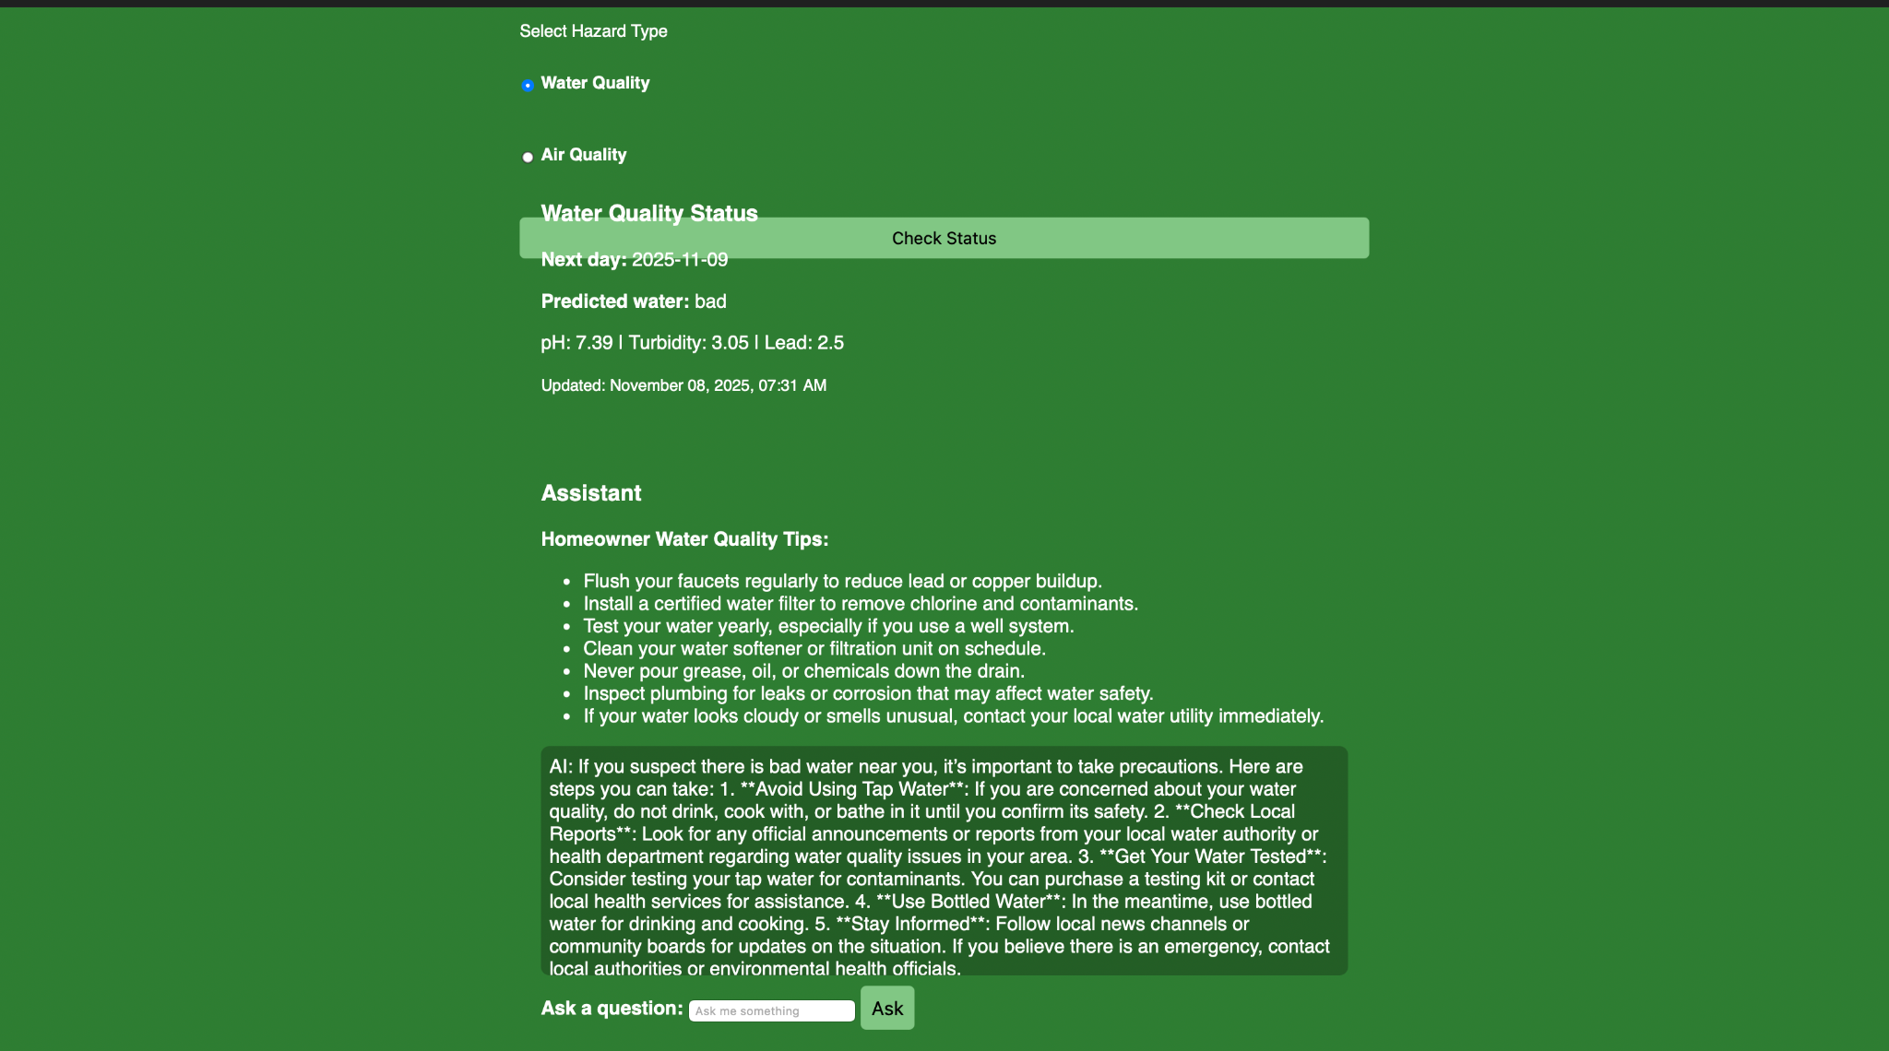
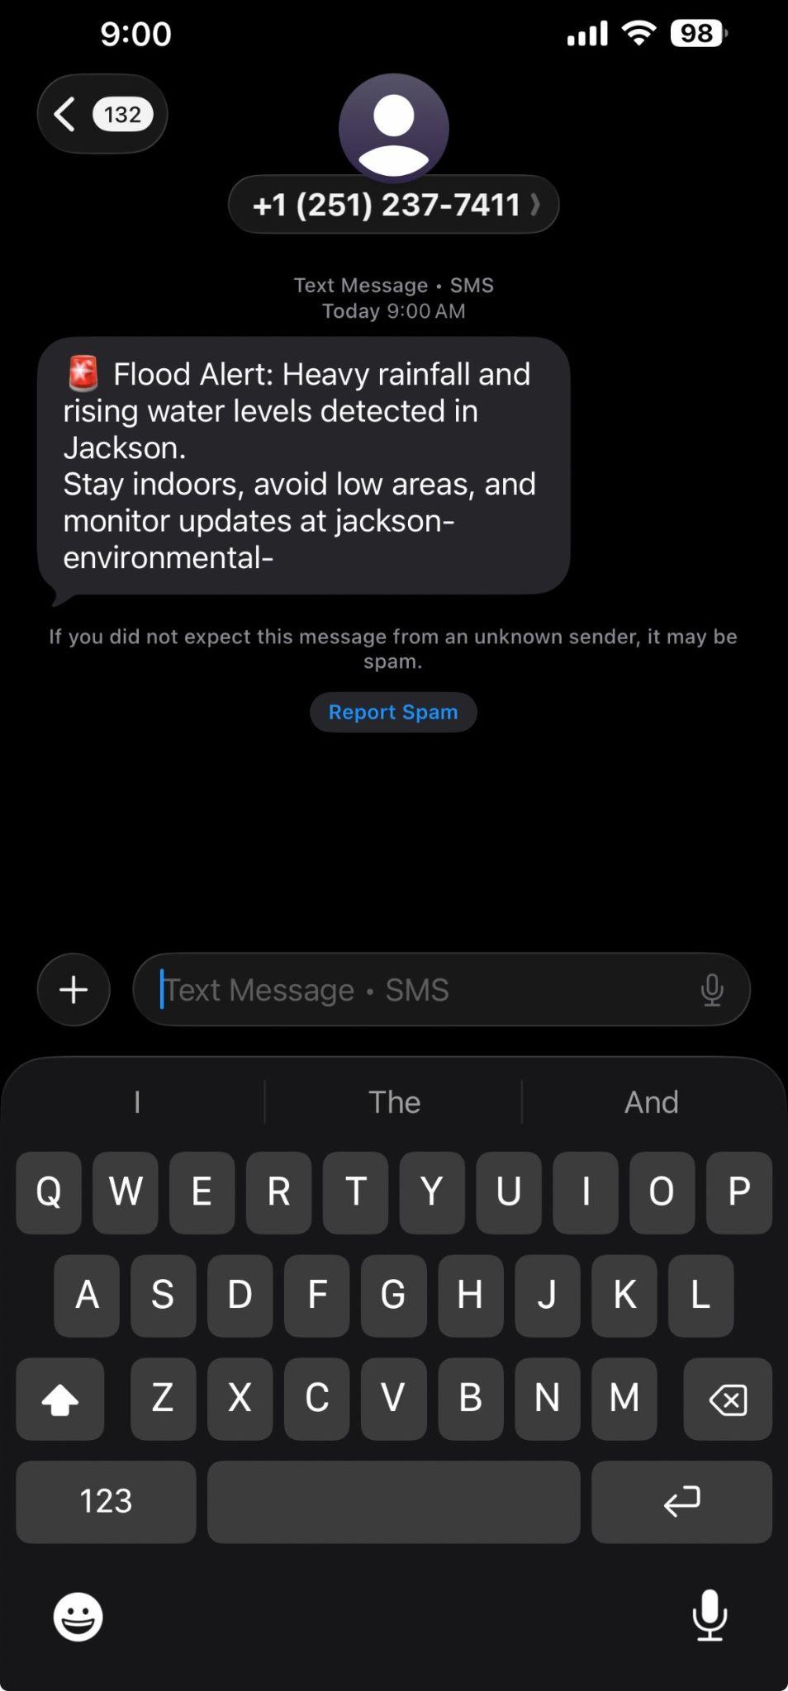
Jackson Environmental AI: How It Works
(Demo)

